Slide 1

Overscan and sync scrolling
“it’s cycles all the way down”
by Troed of SYNC

Slide 2
Overscan
Sync lock
Sync scrolling

Slide 3
Credits
Paulo Simoes (LJBK)
Ijor
Alien / ST Connexion
.. and a little bit me

Slide 4
Overscan

Slide 5
History
[lower] Border removal invented by Alyssa, released by TEX Sept 1987
[right] First released by TEX (Amiga demo, March 1988)
[left] First released by TNT Crew (Death of the Left Border, 1988)

Slide 6
[upper (60Hz)] First released by XXX International (July 1988)
[fullscreen (unstable)] First released by Omega (Omega Demo, Dec -88)
[upper (50Hz)] First released by TCB (Swedish New Years 88-89)
[fullscreen (stable)] First released by Level 16 (Union Demo, Jan -89)

Slide 7
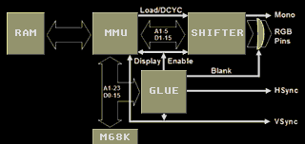
Stabilizer
A Shifter necessity

Slide 8
Two commonly used variants
444: HI nop LO (Ilja, Level 16)
440: MED nop nop LO (Gunstick, ULM)
One cancels HBLANK, one shows pixel data

Slide 9
Forget all you know about switches
move.b d1,(a2) * left
nop
move.b d0,(a2)
89 nop
move.b d0,(a1) * right
move.b d1,(a1)
13 nop
move.b d1,(a2) * stabiliser
nop
move.b d0,(a2)
12 nop

Slide 10
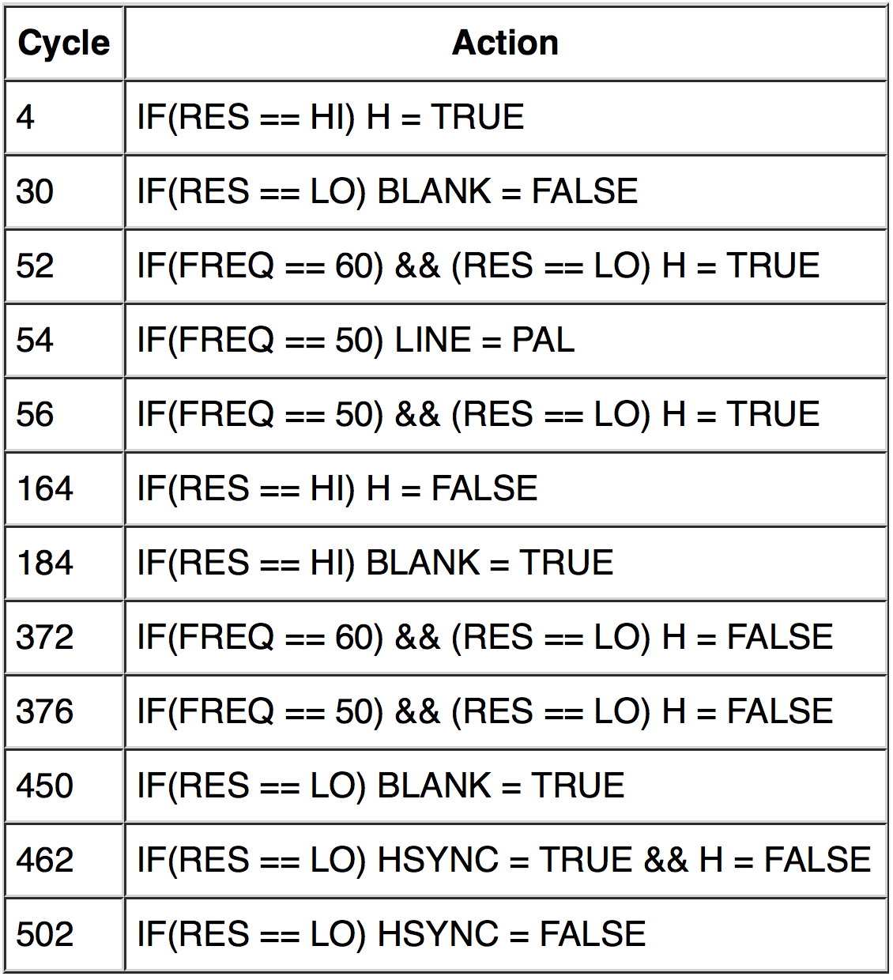
GLUE statemachine
(ST)
Notes:
See http://www.atari-wiki.com/?title=ST_STE_Scanlines for the full writeup

Slide 11
Wakestates
2006 “cold & warm wakeup modes”
2012 “WS1-4” – 2 cycle precision
Research mostly by Paulo Simoes (LJBK)
Before this everyone thought it was due to multiple revisions of Atari hw

Slide 12
GLUE-CPU unsync
Offset 0 reads values at cycle 56 (FREQ) and 57 (RES)
Offset 1 reads values at cycle 57 (FREQ) and 58 (RES)
Offset 2 reads values at cycle 58 (FREQ) and 59 (RES)
Offset 3 reads values at cycle 59 (FREQ) and 60 (RES)

Slide 13
GLUE-CPU unsync
WS1 (DL6): Changes made by 56 (FREQ), 56 (RES)
WS3 (DL5): Changes made by 56 (FREQ), 58 (RES)
WS4 (DL4): Changes made by 58 (FREQ), 58 (RES)
WS2 (DL3): Changes made by 58 (FREQ), 60 (RES)
… we do have 2 cycle granularity!

Slide 14
Classic demos with WS effects
TCB snow screen in Swedish New Years 89-90
  Someone might well have gotten the idea for sync scrolling from that effect
ULM fullscreen issue

Slide 15
230 and 224 byte fullscreen lines
Leonard / Oxygene stumbled upon “short left border” in 2006 (atari-forum thread)
  Re-discovered and now popularized by DHS

Slide 16
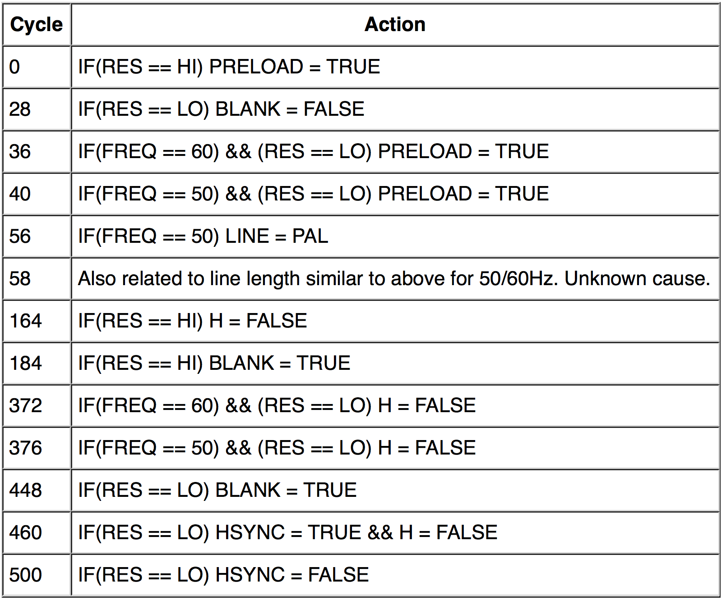
GLUE statemachine
(STE)
Notes:
See http://www.atari-wiki.com/?title=ST_STE_Scanlines for the full writeup

Slide 17
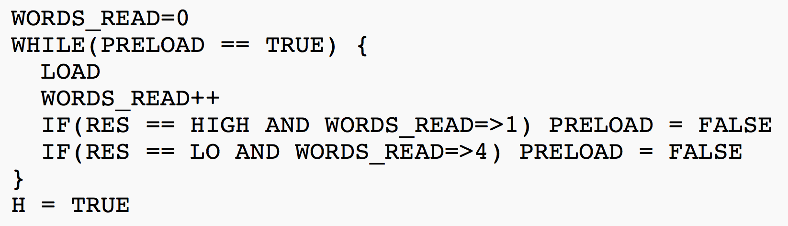
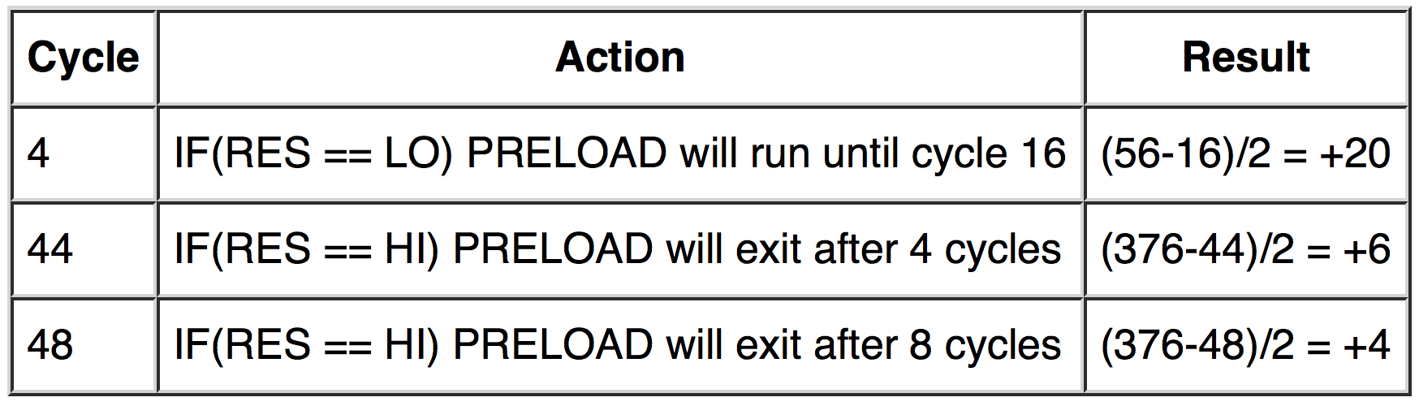

Slide 18
Optimized fullscreen line
0: HI
8: 50Hz
16: LO
376: 60Hz

Slide 19
Stabilize somewhere else?
0: HI
8: MED
16: LO
24: 50Hz
376: 60Hz
472 cycles free compared to 456
– separated into two vs three blocks

Slide 20
Current status
ST WS1, WS3, WS4
ST WS2 – but depending on Shifter state
STE – maybe (noticed yesterday!)

Slide 21
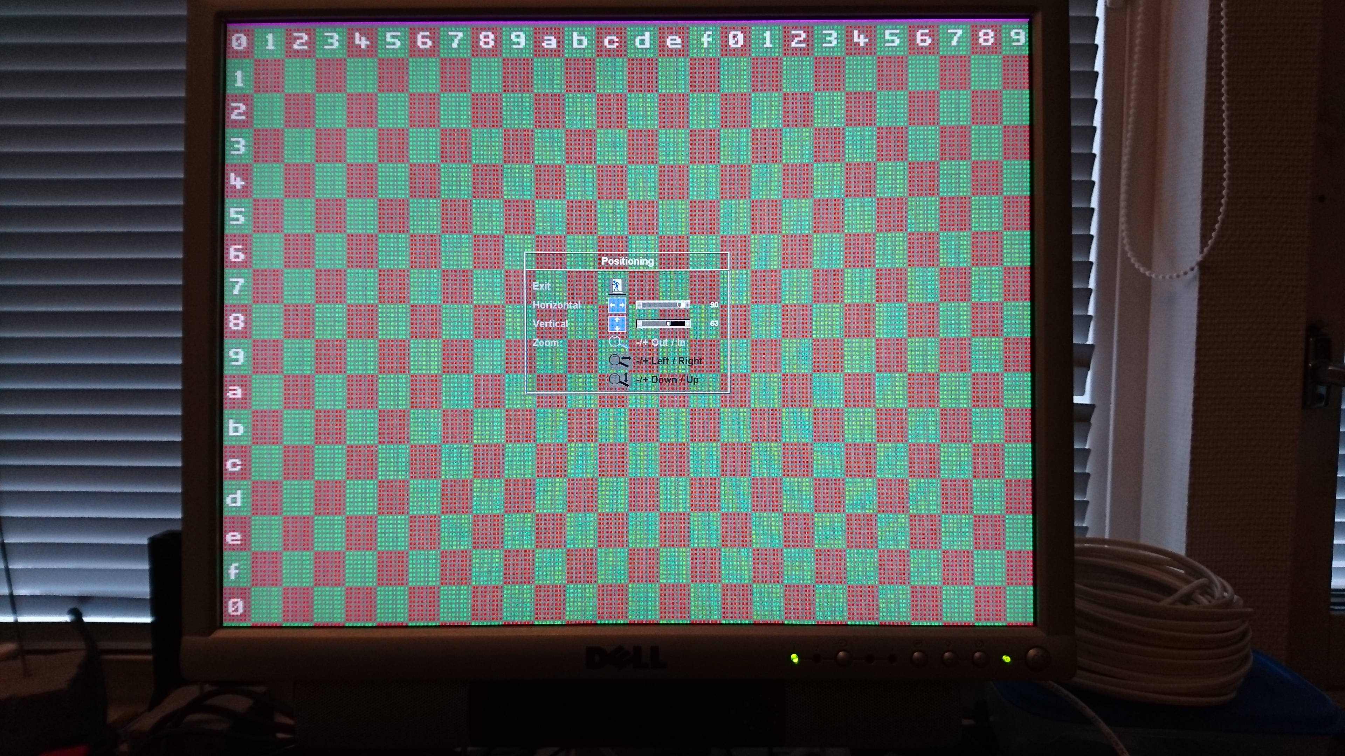
415
X
276*

Slide 22
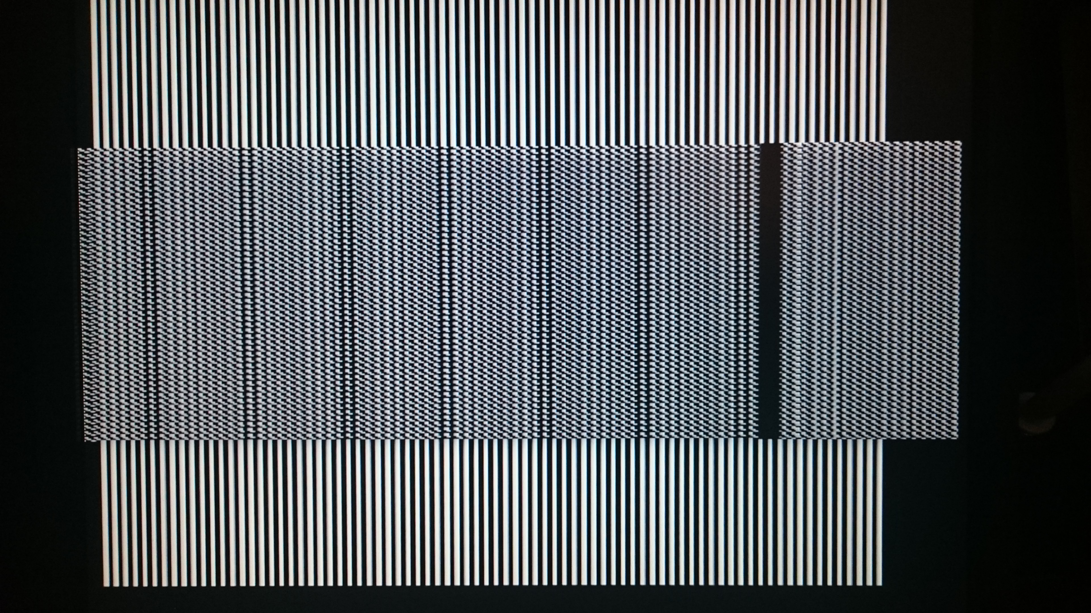

Slide 23
Sync lock

Slide 24
Regular sync lock
Read video pointer, invert delay, done
Top image line needed for sync

Slide 25
HBL sync lock
Ijor (thread on Atari-Forum)
68000 auto vector E-clock
  Detect the jitter
  Insert anti-pattern at HBL line 33
Adds an extra fullscreen line, allows all combinations on first line
Notes:
http://www.atari-forum.com/viewtopic.php?f=68&t=9527&hilit=68000+clock+cycles+table&start=125

Slide 26
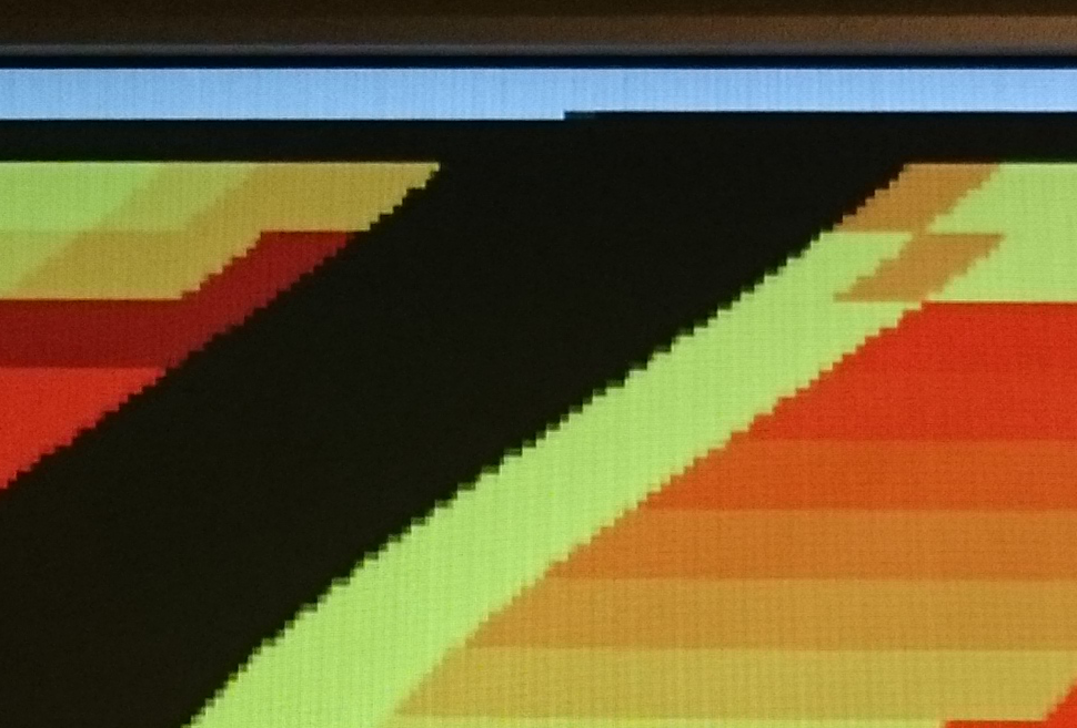

Slide 27
Sync scrolling

Slide 28
Sync scrolling
TCB (Cuddly/SoWatt/Enchanted Lands)
  Only left/right borders – 15 lines
Sync (Swedish New Year 89-90)
  9 lines
Griff / Inner Circle
  7 lines
…

Slide 29
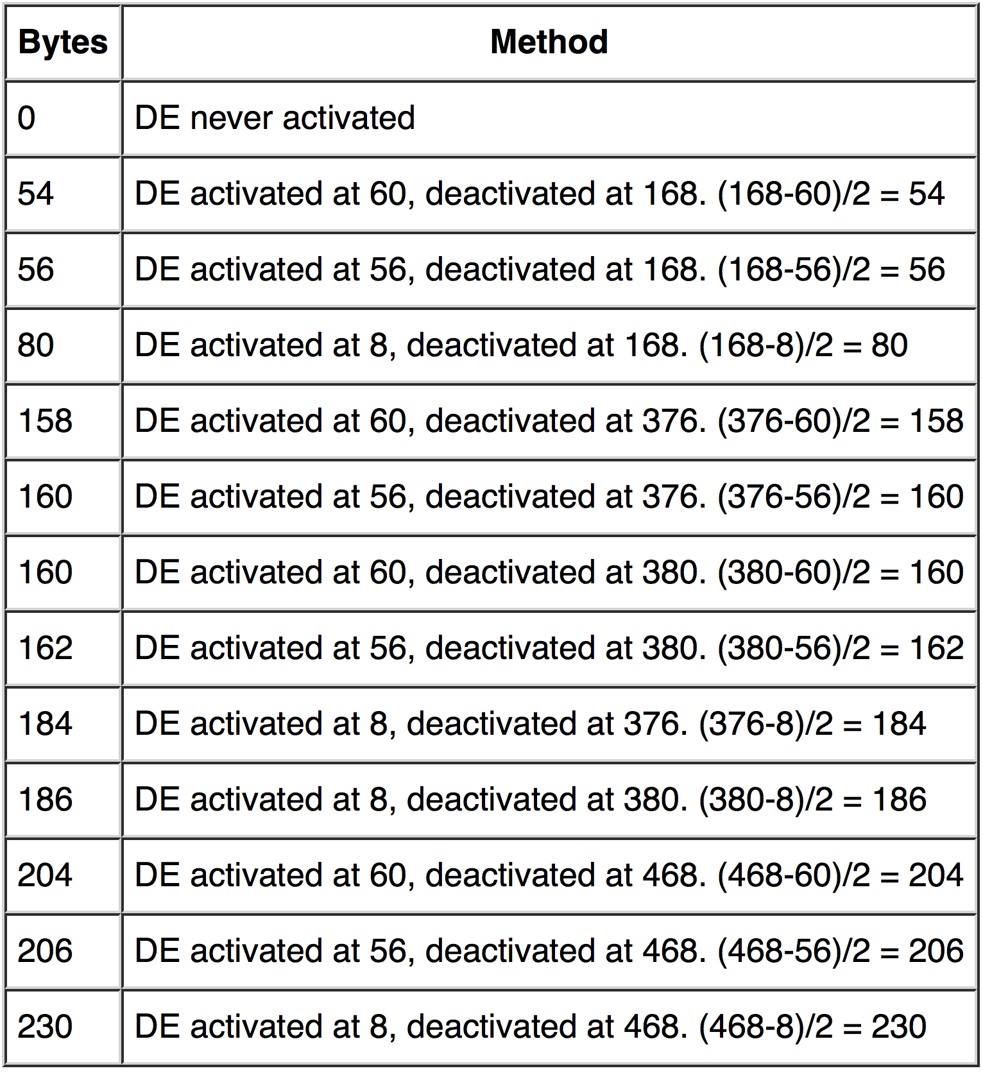
12 line length combos
=
All 128 offsets in just 4 lines
Notes:
See http://www.atari-wiki.com/?title=ST_STE_Scanlines for how these values are calculated

Slide 30
GLUE is not alone in this
4 pixel fullscreen sync scrolling (Alien)
4 pixel non-fullscreen sync scrolling (LJBK)
These are Shifter effects

Slide 31
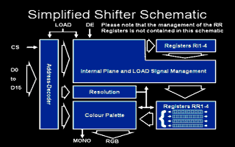

Slide 32
Shifter statemachine
Number_of_read_bitplanes = 0
REPEAT
IF Load is active THEN IR[Number_of_read_bitplanes] = Data sent from MMU
Number_of_read_bitplanes = Number_of_read_bitplanes + 1
IF Number_of_read_bitplanes == 4 AND IF DE is active
THEN RR1 = IR1; RR2 = IR2; RR3 = IR3; RR4 = IR4
IF Number_of_read_bitplanes == 4 THEN Number_of_read_bitplanes = 0
END_REPEAT

Slide 33
4 pixel sync scroll
Alien/ST Connexion in Punish Your Machine
Open left border (HI)
Go to medium res
Wait X cycles
Go to low res

Slide 34
“Oh crap shifted bitplanes”
All coders ever have written a fullscreen has seen this
… exploited by LJBK (Paulo Simoes) in 2012

Slide 35
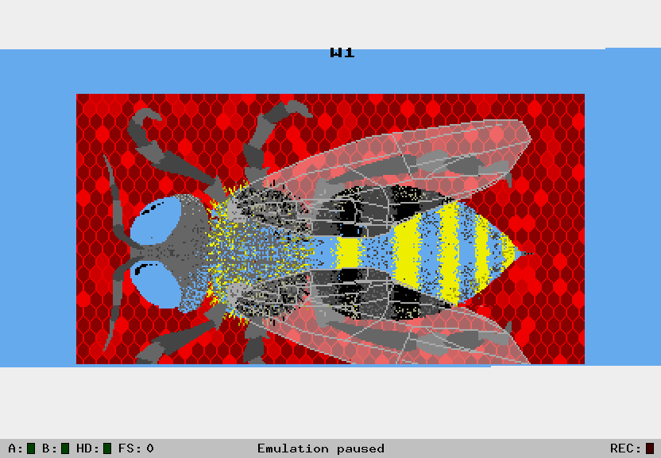
LJBK’s 4 pixel non-fullscreen sync scroll
Deterministically unstabilize
the Shifter leaving a predictable number of words before screen start …
… and get it to work in all wakestates …
… and …
Notes:
http://www.atari-forum.com/viewtopic.php?f=16&t=24855&hilit=horisontal&start=275

Slide 36
Current status
0, -4, -8, -12 in WS2, WS4 & often WS3
0, -4, -8 in WS3 (sometimes) and WS1
Viewer has to select which method is non-banded. Wait, what’s “banded”?

Slide 37
Only 4 wakestates?
Banded lines
Spectrum 512 pixels
Possible internal Shifter clocks, or MMU desync
Migratory states

Slide 38


Slide 39
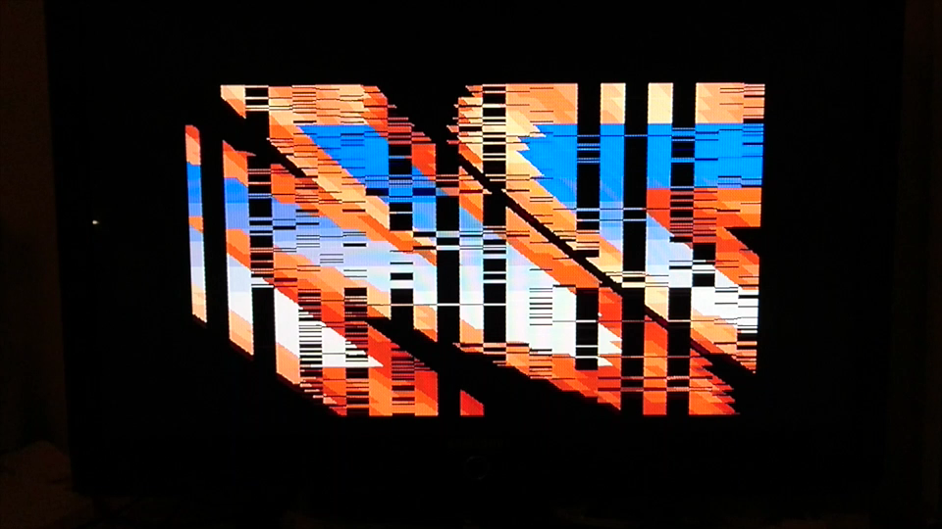

Slide 40
“Every 16 pixels”
The most important substate to solve for future ST/STE overscan insights
Now comes tentative research …

Slide 41
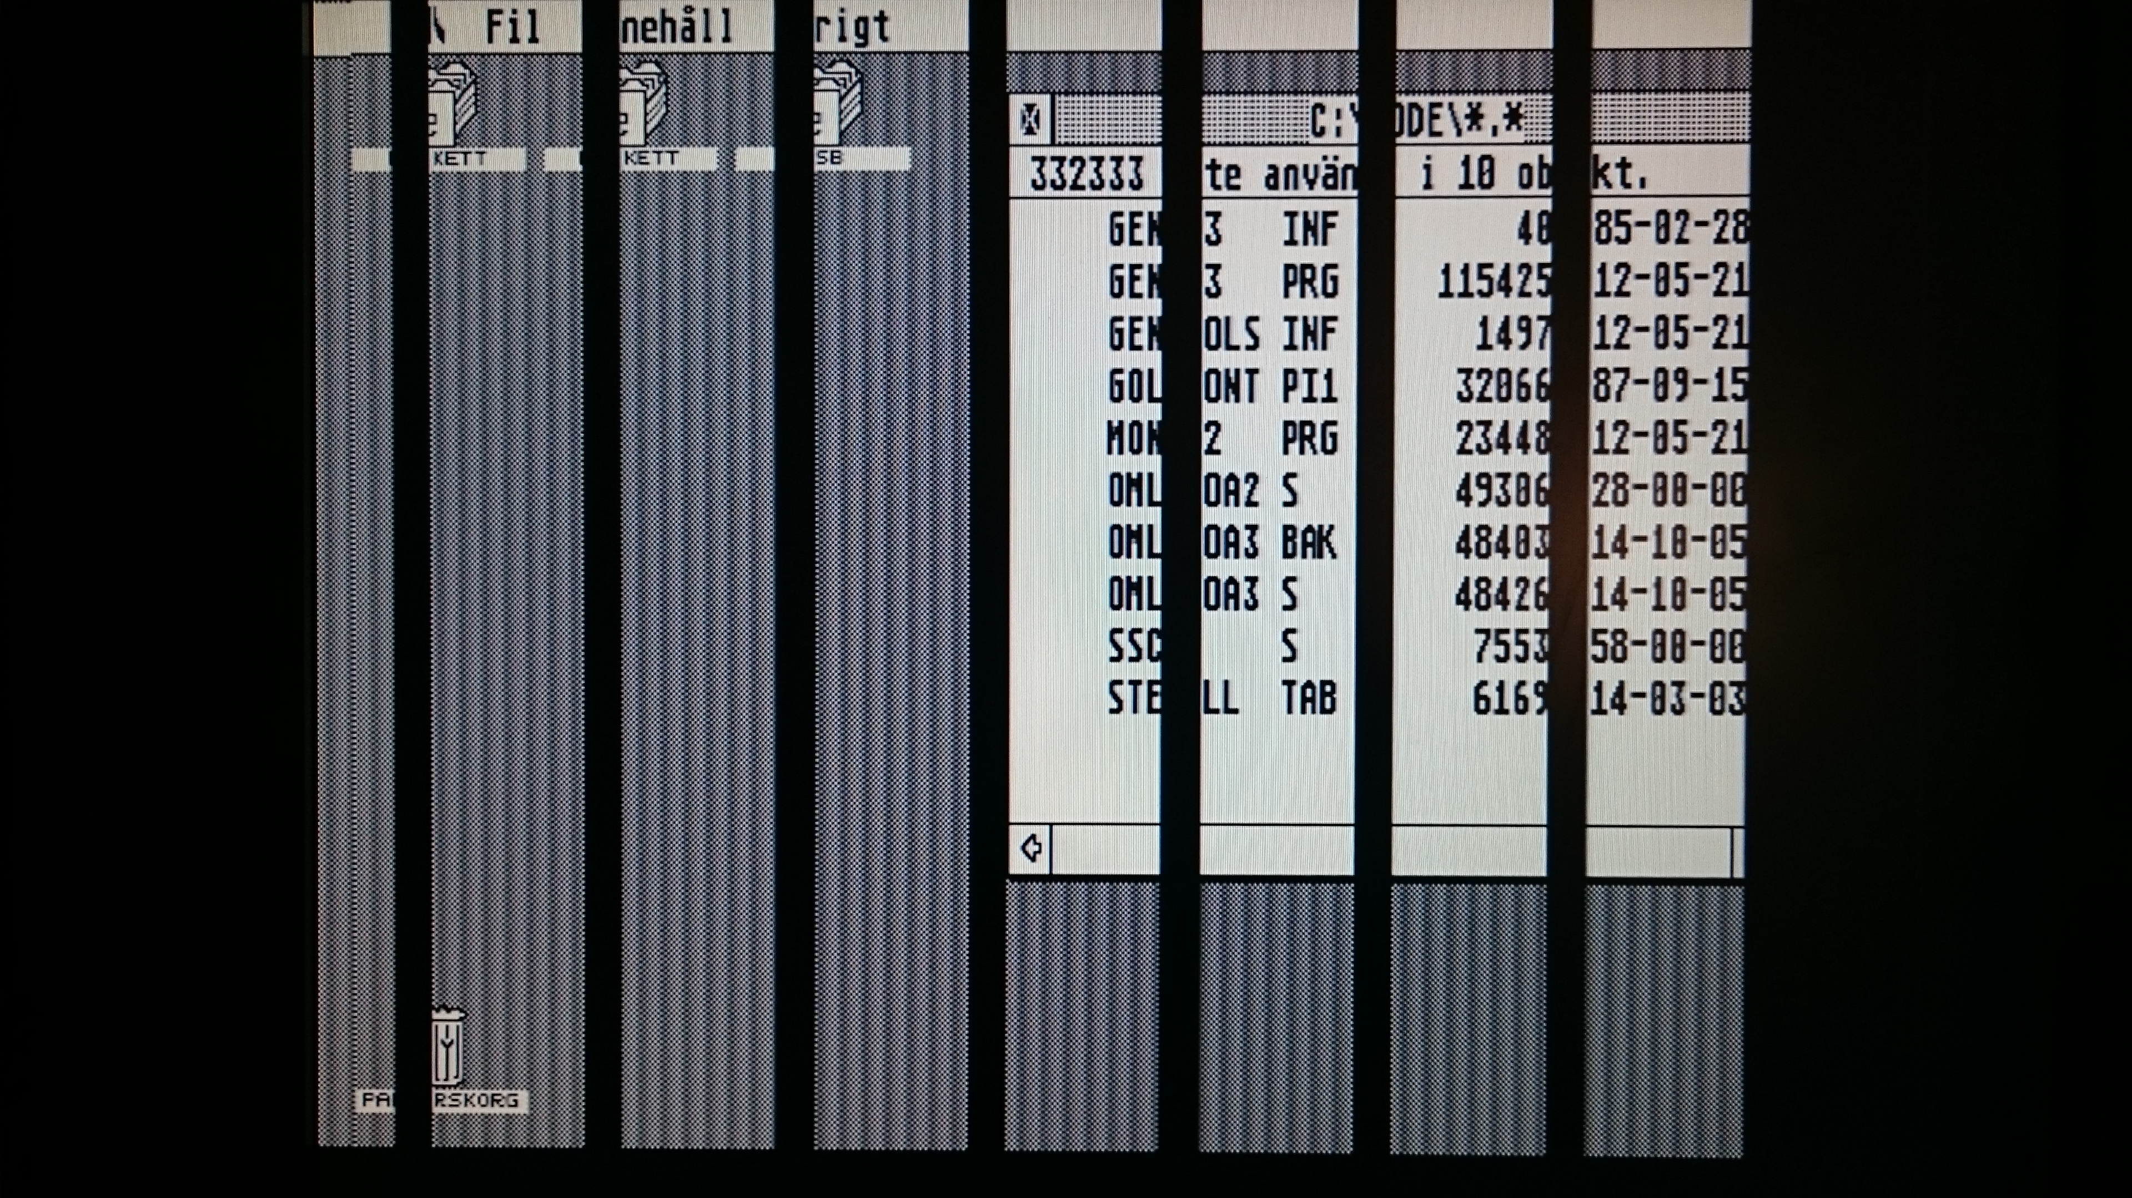

Slide 42
Seems to depend on memory address, so, entering C64 VSP territory …
“The dreaded VSP crash is caused by a metastability condition in the DRAM.”
http://www.linusakesson.net/scene/safevsp/

Slide 43
What’s next?
Snooping the data bus :P

Slide 44
LET’S WRAP

